Slide 1
Application Fluidization Overview

Slide 2
Typical Enterprise App Install
Configuration Management (CM) Tool installs Runtimes according to hierarchy configurations, system wide – the CM Tool effectively is Configurations hierarchy + Operations DAG
CM Tool triggers App install
App Installer unpacks the app package
Embedded runtime is ignored / pruned
At execution time no custom step is required to find embedded JDK - it is hard coded

Slide 3
Custom Application Install Steps
A number of actions is delegated to the Installer:
unpacks the app package with an embedded JDK
Legacy version had embedded JDK path hard coded at multiple levels
New version inspects if Enterprise JDK is present (directory scan, may vary with how visible the Enterprise JDK installs itself)
creates a custom.properties file with JDK info
Inside the app, every JDK path sensitive code and scripts is updated to utilize custom.properties

Slide 4
Another Runtime hosting Tool Example
Puppet Testing Framework - similar to (predecessor of) Chef Inspec
CM Tool installs app which installs Ruby Runtime environment in custom location
Ruby, Python, Java, Node.JS, Go, .Net natively support multiple side by side environments.
Ruby is the origin of ServerSpec (replicas exist). There is no system Ruby by default. PTF relies on uru (kind of rvm) and Puppet for metadata interpolation
Integration metrics collected at specific Puppet stage
App and its embedded Runtime is removed by CM Tool

Slide 5
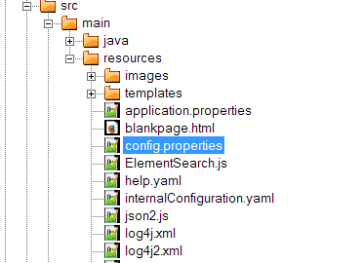
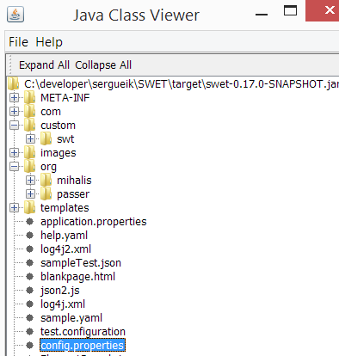
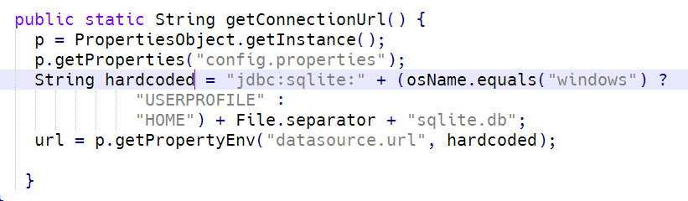
Configuration
Flexible override hierarchy
configuration from file from a fixed or relative path ( from ${user.dir})
configuration resource from the Application jar
defaults hard coded in the Application source code
specific location when packed as Maven plugin
1
2
3

Slide 6
Configuration
Minimal String Interpolation – optional, handy
Foo: 42
Bar: answer is ${foo}
Home: ${USERPROFILE}
Can handle ops and web-friendly formats : YAML,INI,JSON,XML
Recognized by the callers: Java, Powershell, Bash, Perl

